Slide 1
SHOPPING and MONEY
NAKUPOVÁNÍ A PENÍZE
Mgr. Martina Mádrová

Slide 2
BRITISH MONEY
PENNY(jednotné č.) / PENCE (množné č.)
značíme zkratkou p /čteme: pi:/
POUND (jednotné č.) / POUNDS (množné č.)
značíme symbolem £ /čteme: paund/ česky LIBRA
£1 = 100p (=50p + 50p, 5*20p, 10*10p …)
£1 – ONE POUND £2.50 – TWO POUNDS FIFTY
£20 – TWENTY POUNDS £1.70 – ONE POUND SEVENTY
50p – FIFTY p £200 – TWO HUNDRED POUNDS
25p – TWENTY-FIVE p

Slide 3
COINS (mince)
1 penny = 1p /pi:/
2, 5, 10, 20, 50 pence = 2, 5, 10, 20, 50 p /pi:/
£ 1, 2 /wan paund, tu: paunds/
LINKS (odkazy)
Coins of the UK (https://www.youtube.com/watch?v=s4VUZZfh2TE)
UK coin song (https://www.youtube.com/watch?v=jHkUPDjum_E)
What is in the piggy bank? (https://www.youtube.com/watch?v=vs8F_g3MGtM)

Slide 4
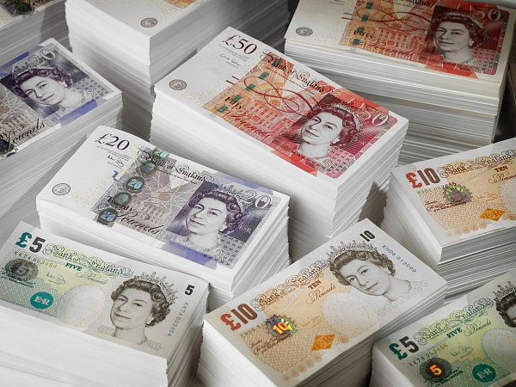
BANKNOTES (bankovky)
£ 5, 10, 20, 50

Slide 5
SHOPPING (Nakupování)
a shop assistant - prodavač/ka
a customer – zákazník
Phrases:
Can I help you? Mohu vám pomoci?
How much is this …? Kolik stojí … ?
How much are these … ?
It‘s £5. Stojí to 5 liber.
Can I have …? Mohu mít/ Mohu si vzít …?
Anything else? Ještě něco jiného?
That‘s £10 then. Celkem to stojí 10 liber.
Here you are. Tady máte.

Slide 6
Shopping - dialogue
Good morning. Can I help you?
Yes. How much is this pen?
It‘s 75p.
Thanks. And how much are these balloons?
They‘re 50p each.
Can I have a pen and five balloons, please?
That‘s £3.25 then, please.
Here you are.
Thank you. Bye.
Good bye.

Slide 7
SHOPPING SONG ☺
https://learnenglishkids.britishcouncil.org/songs/shopping

Slide 8
Resources:
https://www.fxstreet.cz/img/web/fx1/1577607499-britska%20libra.jpg
Project 1 Third edition, Oxford, p.67/7
https://learnenglishkids.britishcouncil.org/songs/shopping
https://www.youtube.com/watch?v=s4VUZZfh2TE
https://www.youtube.com/watch?v=jHkUPDjum_E
https://www.youtube.com/watch?v=vs8F_g3MGtM

